Slide 1

BI-APP Monthly Management Review Syed Mohammed Thameem
07 April 2021
ENGINEERING THE CHANGE

Slide 2
BI-APP Updates
APRIL 2021
Overall Summary:-
Analysed the Web Page of Philips Global Career Page.
Developed the changes to be made on Scrapping side.
There was a change occurred in website of Abbott hence the code was changed accordingly
Currently fixing and adding features to Alcon by adding the column for Exact date of job posted which was not been added initially.
Philips:-
Understanding of source page (HTML and CSS) of Philips Global Career was done thoroughly.
Developed the code for scrapping the data from the Philips Global Career page.
Made changes according to requirements in different files.
Executed and Generated Report for the same.
Abbott:-
Changes were made on Front end side of the Abbott career hence the changes were made in code accordingly.
Executed and Generated Report for the same and sent for production
Alcon:-
Currently Adding a new feature as a new column for finding exact dates of jobs posted.

Slide 3
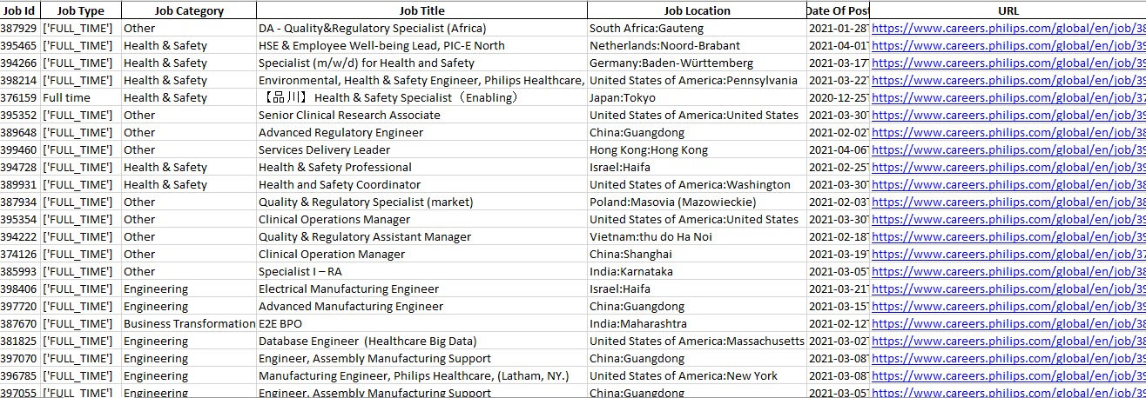
Philips Report

Slide 4
BI-APP Updates
MAY 2021
To add on some analytics on Philips Report according to given requirements

Slide 5

Thank You

